Slide 1
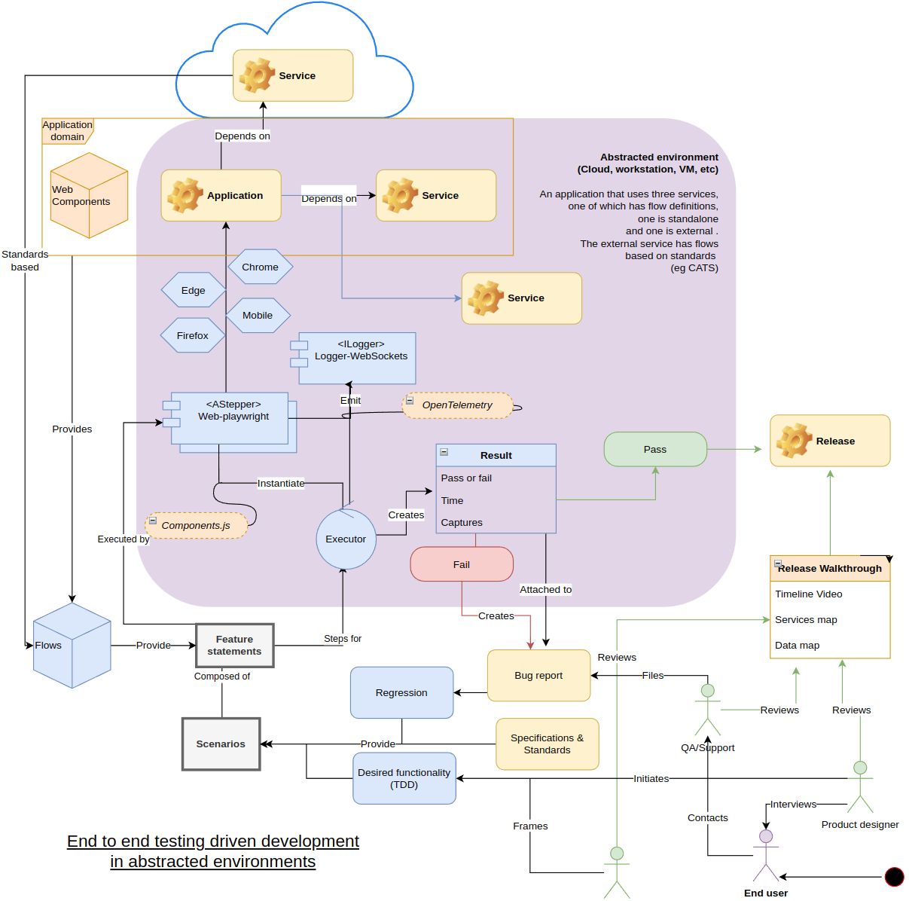
Haibun End to end specification driven development in abstracted environments
Load tests
https://github.com/withhaibun/haibun-load-tests
November, 2023
Overview diagram

Slide 2
Important elements of Haibun
Reduce the friction for developing high standard products (specs, tests, documentation)
Understandable by anyone, produce clear artifacts
Fits into existing systems, one piece of the puzzle
Development pipelines
Local or cloud environments
Very high level of re-use: Specification → flows → features → scenarios -> steps
Re-use for load tests

Slide 3
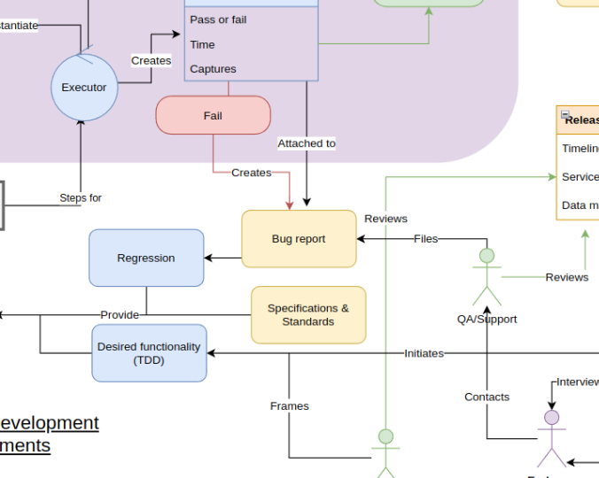
Runs in cloud pipeline
Local or cloud resources
How Haibun fits into development
Define product through specification & features
Run feature tests locally for wide / repetitive tasks
Run in pipeline to verify features and standards
Matches spec
Functional
Accessible
Product up to date documentation
…
Support quality prompt driven development? https://githubnext.com/projects/speclang/

Slide 4
Standalone test
Feature: A form and counter
Backgrounds: counter
When I have a valid random username <username>
Go to the form webpage
When I input <username> for user name
And I click the button Submit
Then I should see Success
And the URI query parameter username is <username>
local-tests/client-test

Slide 5
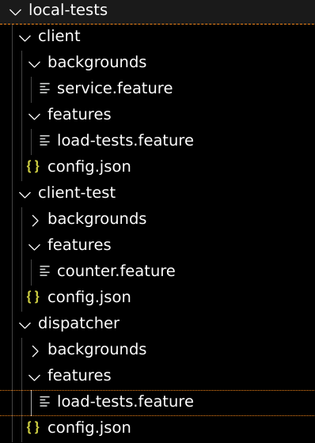
Test dispatcher
Feature: Simulated load test
Routes used for load testing.
serve files at /counter from "counter"
The following will dispatch tests from a local folder.
Dispatch load tests from "local-tests/client-test"

Slide 6
Clients
Feature: Client load test
start load test client
version: '3.8'
services:
local-client:
build: .
env_file:
- env-client
network_mode: "host"
Feature
FROM mcr.microsoft.com/playwright:v1.39.0-jammy
WORKDIR /usr/src/app
COPY package*.json ./
RUN npm install
COPY . .
COPY . ./
COPY .dockerignore ./
CMD ["npm", "run", "local-client"]
docker-compose.yml
HAIBUN_O_WEBPLAYWRIGHT_STORAGE=StorageFS
HAIBUN_O_WEBPLAYWRIGHT_HEADLESS=true
HAIBUN_O_HAIBUNLOADTESTSSTEPPER_TOKEN=local92
HAIBUN_O_HAIBUNLOADTESTSSTEPPER_TRACKS_STORAGE=StorageFS
HAIBUN_TRACE=true
HAIBUN_O_OUTREVIEWS_STORAGE=StorageFS
HAIBUN_O_HAIBUNLOADTESTSSTEPPER_DISPATCHER_ADDRESS=http://192.168.0.200:8123
env-client
Dockerfile

Slide 7
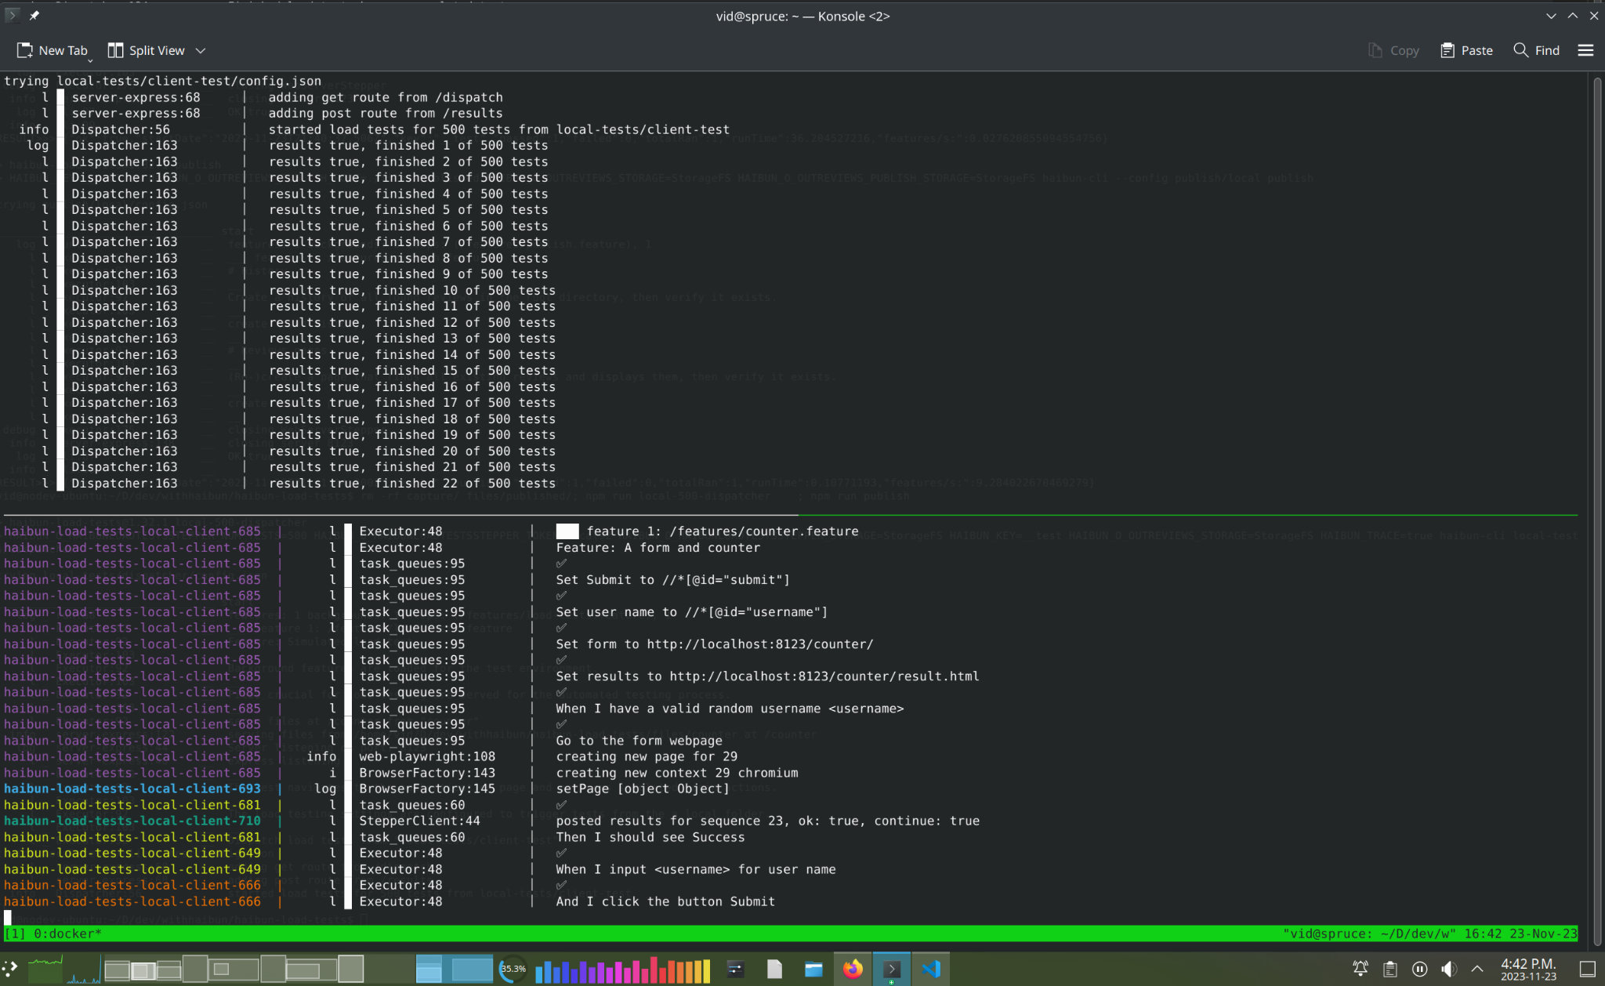
Running the load test locally using Docker
docker compose up --build --scale local-client=50

Slide 8
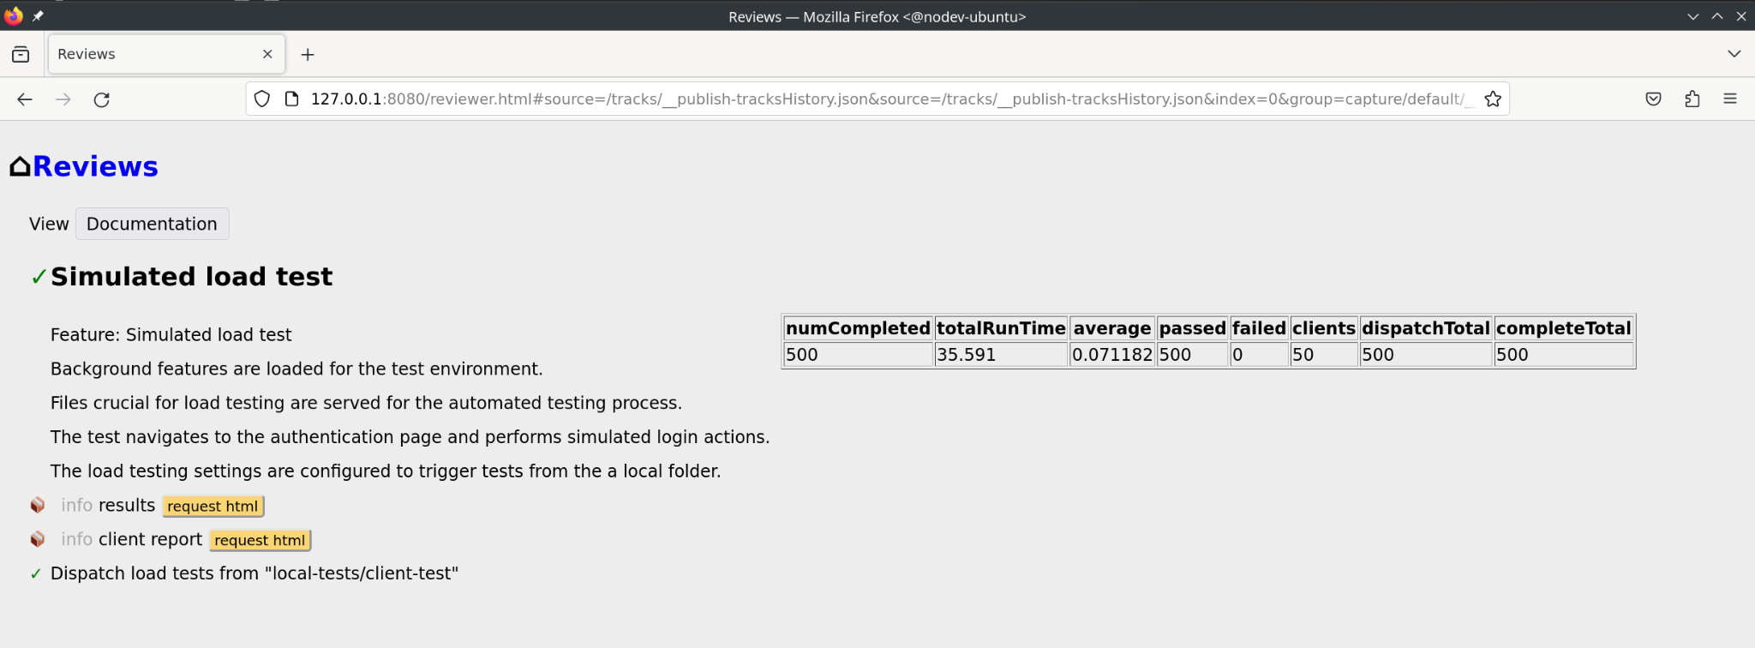
Report
Load test results are added to the set of generalized Haibun test artifacts.

